Slide 1

Classification of water resources and determination of the comprehensive reserve and Resource Quality Objectives in the Mvoti to Umzimkulu Water Management Area
Proposed methodology to way up the level of protection against water use towards finding the desirable balance and Management Class
Presented by: Pieter van Rooyen
26 November 2013

Slide 2
What need to be balanced?
Degree of the ecological health defined by Ecological Categories of biophysical nodes (none-monetary)
Ecological Goods and Services Attributes (none-monetary)
Socio-Economic implications (quantitative: monetary and job count)

Slide 3
Integrated Assessment of Scenarios
Elements
Variables
Socio-Economic Implications
Ecosystem Services
Ecological health
Water Resource System
Integrated Units of Analysis
Biophysical Nodes
River Reaches
(Resource Unit)
Scenario Assessment

Slide 4
What are scenarios?
Scenarios, in context of water resource management and planning are plausible definitions (settings) of all the factors (variables) that influence the water balance and water quality in a catchment and the system as a whole

Slide 5
What are scenarios used for?
Different levels of water use and protection are evaluated with the aim to find a preferred balanced scenario
Water Resource Classification is the process to evaluate and recommend what that balance scenario entails

Slide 6
Catchment Analysis
Catchment Resource Availability
Ecological
Water Requirements
Socio-Economic
Water Requirements
Protection
Use
Management Class
(Decision)

Slide 7
Scenario Evaluation Process
Vision
Scenario Description
Assign attributes to EWR nodes
Water
Availability Analysis
Estimate Consequences
Rank and
optimise
Formulate Alternative Scenarios
Select Scenario Subset
Stakeholder Evaluation
Ecological
EGSA
Economics
Non-Ecological Water Quality
Evaluate against
Vision

Slide 8
Multi-criteria assessment method
For each reach / node
For IUA / system
For all
scenarios
Ecology
Fish
Invertebrates
Riparian vegetation
Relative importance
Weighting process
Score
Degree of
meeting REC
EGSA
Food, fuel
Regulating
Cultural
Prevailing situation
Weighting process
Integrated Comparison (all three variables)
Score
Relative to present
provisions
Economy
GDP
Jobs
Household
Income
Makeup of economy
Weighting process
Score
Relative to base
condition

Slide 9
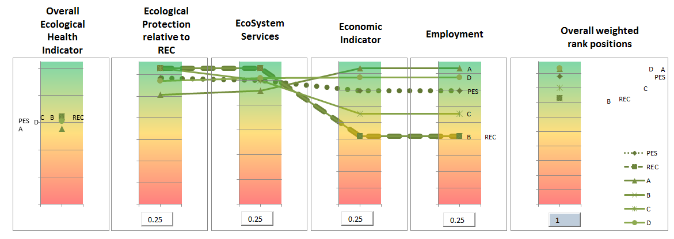
Scenario Comparison Visualisation
REC
PES
Relative weights
Scenarios | Driver Variables
 | Raised Dam | Build New Dam | Re-use treated effluent | Additional allocation | Maintain PES EWR | Release EWR (REC) | Improve Seasonal release pattern
A | • |  | • | •
B | • |  | • | • |  | •
C |  | • (large) |  | • | • |  | •
D | • | • (smaller) |  | • | • |  | •

Slide 10
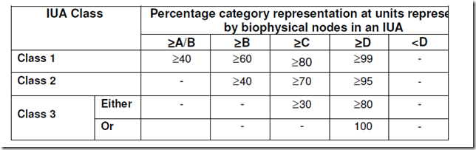
B
Scenario D
Deriving the Management Class
Stream Flow Reduction Activity
Small Dams
B
 | Node grouping in Ecological Categories (EC) (outcome from Scenario D)
EC | A | B | C | D | E
Number | 0 | 2 | 4 | 2 | 1
% |  | 22.2 | 44.4 | 22.2 | 11.1
Weighted % |  | 20.8 | 50.9 | 24.5 | 3.8
Scenario D
Results
D
D
Rural
Irrigation
Rating Rules
Rural
C
Nature Reserve
E
C
Irrigation
C
Industrial
Urban
Management Class III
C
Biophysical Node
EWR Site
Estuary

